Slide 1
Temporal Attention

Slide 2
Temporal Attention
Q
Attention
*
features
K
video
CNN
K'
V
F
*

Slide 3
Method 1
Sum them up
Problem: Fuse the temporal information would cause some loss. Alough the temporal relation is considerred when coding the sequence.
F
Sum
Classification
Output

Slide 4
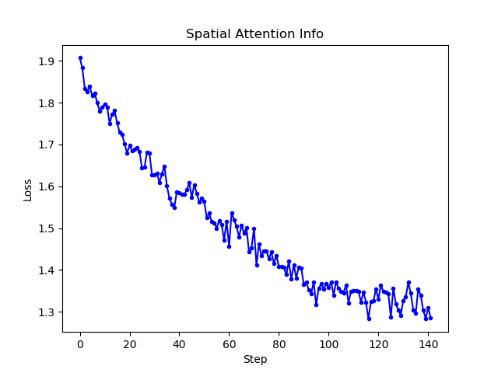
Experiment
Choosed 8 videos from words: 'Alone' and 'Twenty' to train our model, and it got 100% accuracy finally.
Test the model on another two videos, the outcome is correct.
But it may still have gotten overfitting. Further experiments and parameters modification is needed.

Slide 5
Method 2 (if have time)
Use a state machine
When we human beings are recognizing a sign language:
We would give a first speculation when watching the beginning of the motion. With the motion goes, we would make further judgement based on the previous speculation, which would be more accuracy.
To train such model, the output of each step should be taken into training. (Process supervise)
Sequence: | H | He | Hello | Ground True
Hi | 30% | 0% | 3% | 0%
He | 40% | 50% | 2% | 0%
Hey | 60% | 60% | 5% | 0%
Hello | 30% | 80% | 95% | 100%
Loss Function

